Slide 1
Introduction to Compiler
Lecture 01

Slide 2
What is a compiler?
Programming problems are easier to solve in high-level languages
Languages closer to the level of the problem domain, e.g.,
SmallTalk: OO programming
JavaScript: Web pages
Solutions are usually more efficient (faster, smaller) when written in machine language
Language that reflects to the cycle-by-cycle working of a processor
Compilers are the bridges:
Tools to translate programs written in high-level languages to efficient executable code

Slide 3
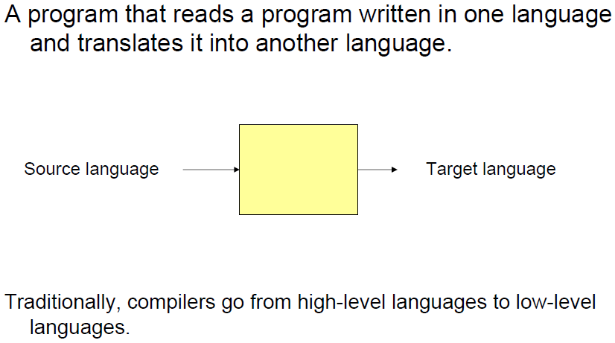
What is a compiler?

Slide 4
Introduction To Compilers
Interpreters:
Compilers:

Slide 5
Introduction To Compilers
1954 IBM develops the 704
Successor to the 701
“Speedcoding”
Software cost >> Hardware cost
First commercial compiler or processor
10 to 20 times slower
Faster to develop programs

Slide 6
Introduction To Compilers
FORTRAN I (1954-1957)
The first compiler
Huge impact on computer science
Led to an enormous body of theoretical work
Modern compilers preserve the outline of FORTRAN I
Rapid Adoption
By 1958, 50% programs are written for FORTRAN I

Slide 7
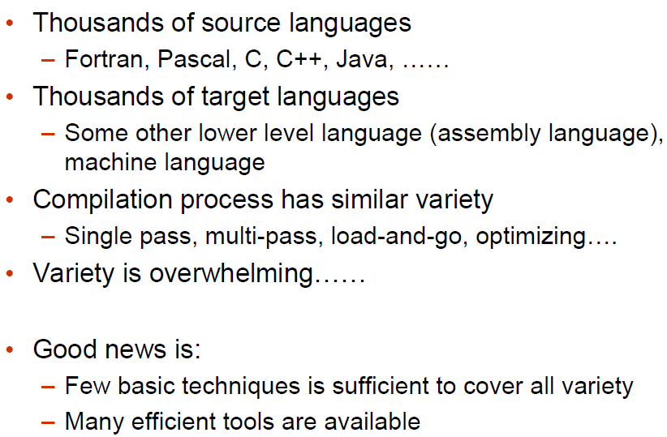
Compilation task is full of variety

Slide 8
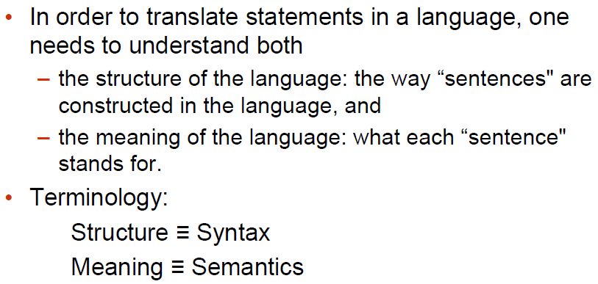
Requirement

Slide 9
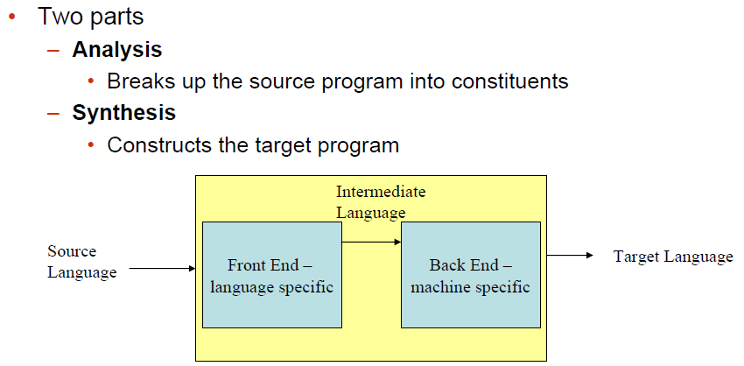
Analysis-Synthesis model of compilation

Slide 10
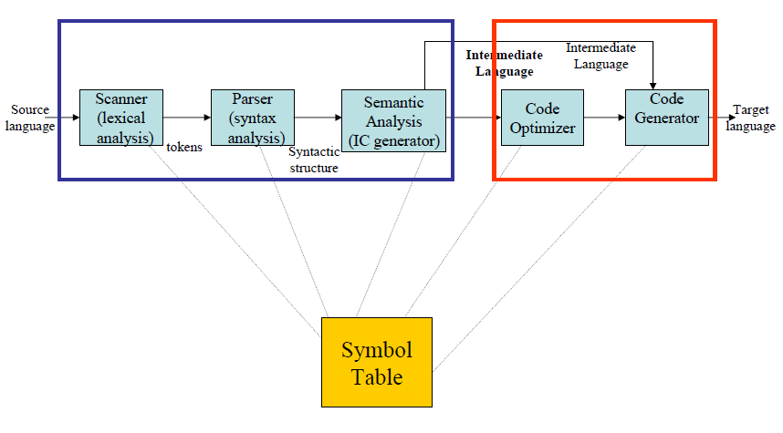
Compilation Steps/Phases

Slide 11
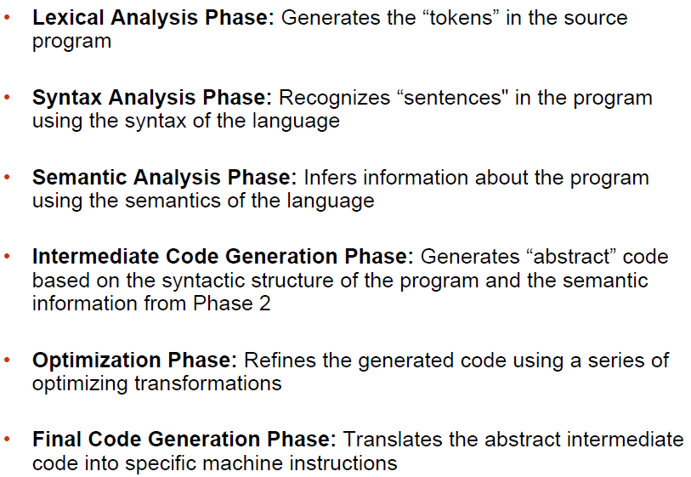
Compilation Steps/Phases

Slide 12
Lexical Analysis
First step: recognize words.
Smallest unit above letters
This is a sentence
ist his ase nte nce

Slide 13
Lexical Analysis
Lexical analysis divides program text into “words” or “tokens”
if x == y then z = 1; else z = 2;
Tokens are the “words" of the programming language
Lexeme
The characters comprising a token

Slide 14
Lexical Analysis
For example
the sequence of characters “static int" is recognized as two tokens, representing the two words “static" and “int"
the sequence of characters “*x++" is recognized as three tokens, representing “*", “x" and “++“
• Removes the white spaces
• Removes the comments

Slide 15
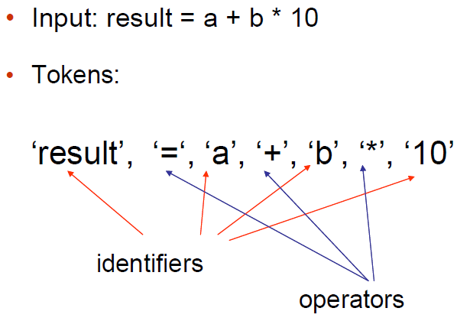
Lexical Analysis

Slide 16
Syntax Analysis (Parsing)
Second Step: Once words are understood, the next step is to understand sentence structure
Parsing = Diagramming Sentences
The diagram is a tree

Slide 17
Syntax Analysis (Parsing)
This line is a longer sentence

Slide 18
Syntax Analysis (Parsing)
if x == y then z = 1; else z = 2;

Slide 19
Syntax Analysis (Parsing)
Uncover the structure of a sentence in the program from a stream of tokens.
For instance, the phrase “x = +y", which is recognized as four tokens, representing “x", “=“ and “+" and “y", has the structure =(x,+(y)), i.e., an assignment expression, that operates on “x" and the expression “+(y)".
• Build a tree called a parse tree that reflects the structure of the input sentence.

Slide 20
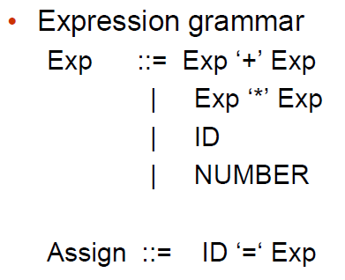
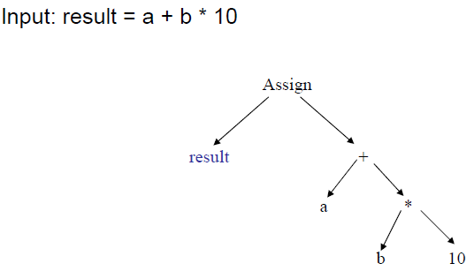
Syntax Analysis (Parsing)

Slide 21
Semantic Analysis
Third Step:
Once sentence structure is understood, we can try to understand “meaning”
This is hard!
Compilers perform limited semantic analysis to catch inconsistencies
Performs type checking
Operator operand compatibility

Slide 22
Intermediate Code Generation
Translate each hierarchical structure decorated as tree into intermediate code
Properties of intermediate codes
Should be easy to generate
Should be easy to translate
Intermediate code hides many machine-level details, but has instruction-level mapping to many assembly languages
Main motivation: portability
One commonly used form is “Three-address Code”

Slide 23
Code Optimization
Apply a series of transformations to improve the time and space efficiency of the generated code.
Peephole optimizations: generate new instructions by combining/expanding on a small number of consecutive instructions.
Global optimizations: reorder, remove or add instructions to change the structure of generated code
Consumes a significant fraction of the compilation time
Simple optimization techniques can be vary valuable

Slide 24
Code Generation
Map instructions in the intermediate code to specific machine instructions.
Memory management, register allocation, instruction selection, instruction scheduling, …
Generates sufficient information to enable symbolic debugging.

Slide 25
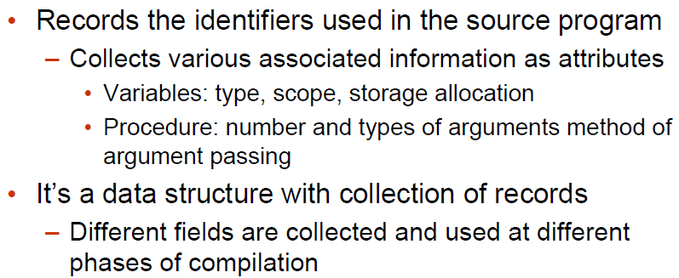
Symbol Table

Slide 26
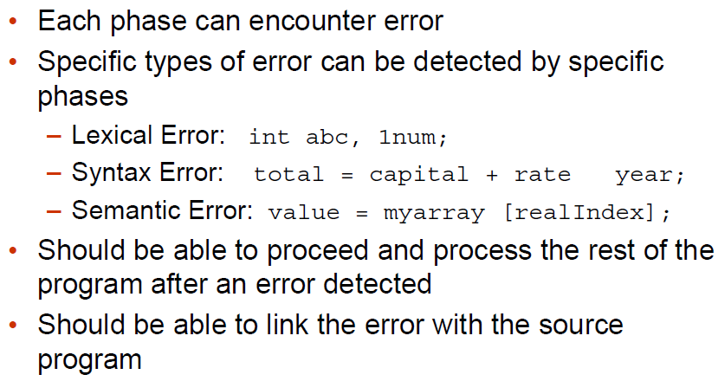
Error Detection, Recovery and Reporting

Slide 27
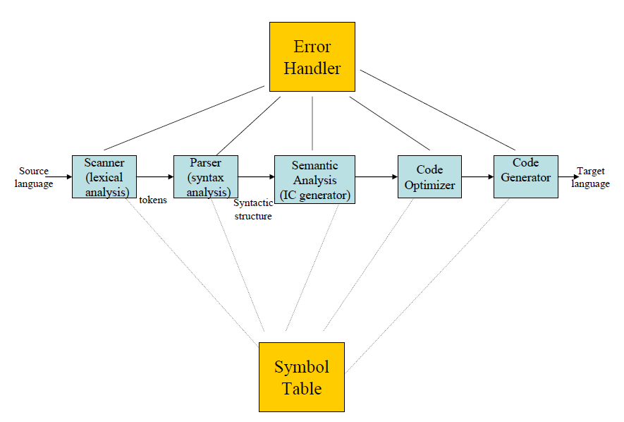

Slide 28
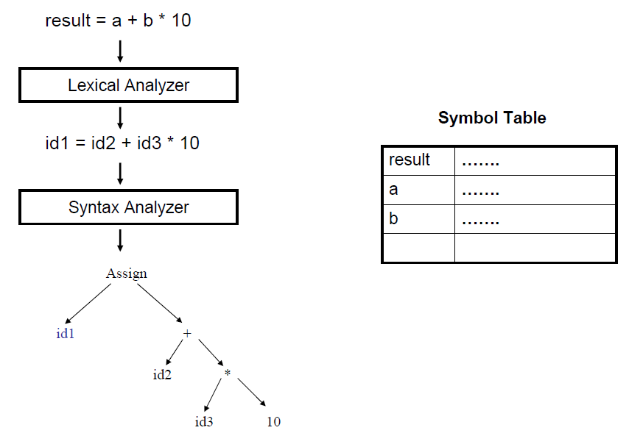

Slide 29
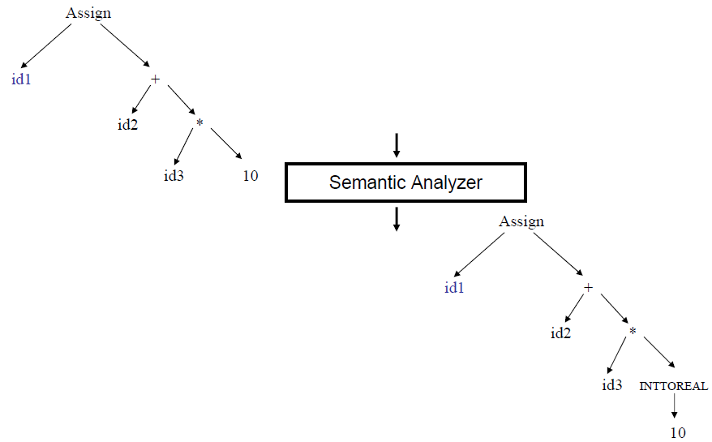

Slide 30
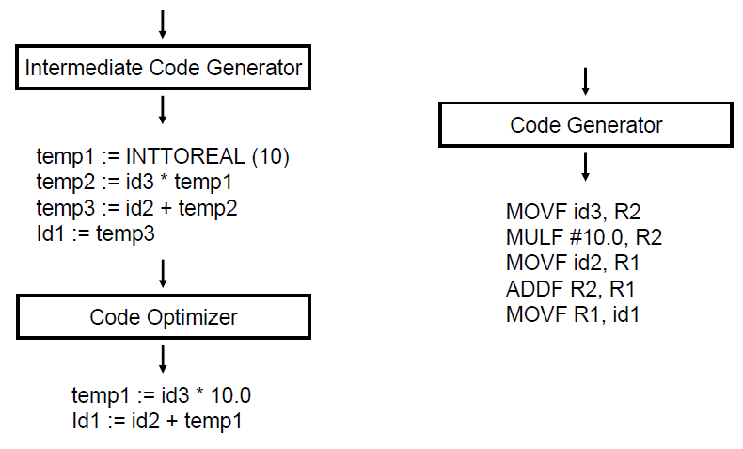

Slide 31
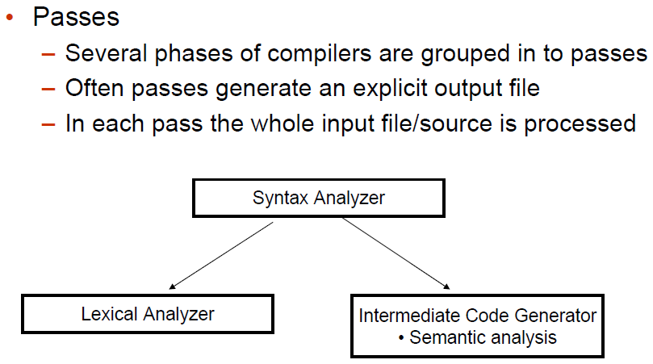
Multi Pass Compilers

Slide 32
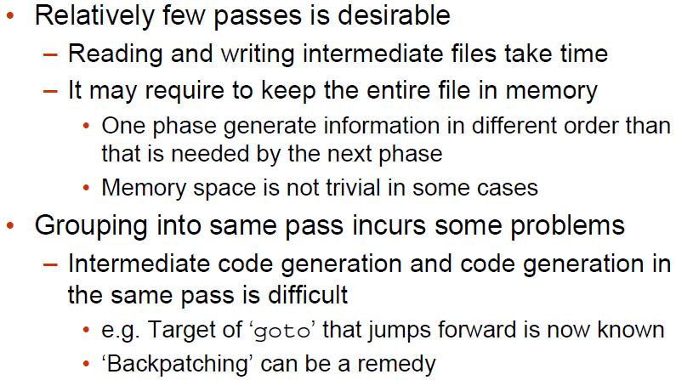
How many passes?

Slide 33
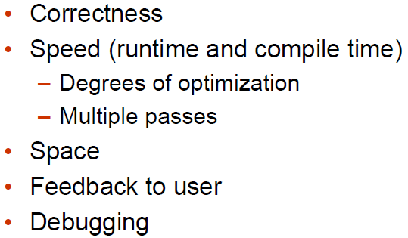
Issues Driving Compiler Design

Slide 34
Other Applications
In addition to the development of a compiler, the techniques used in compiler design can be applicable to many problems in computer science.
Techniques used in a lexical analyzer can be used in text editors, information retrieval system, and pattern recognition programs.
Techniques used in a parser can be used in a query processing system such as SQL.
Many software having a complex front-end may need techniques used in compiler design.
A symbolic equation solver which takes an equation as input. That program should parse the given input equation.
Most of the techniques used in compiler design can be used in Natural Language Processing (NLP) systems

Slide 35
Thank You
Questions?

